Slide 1
Robocars: Computers and Cars get Married And the City is rewritten
Sept, 2013
Brad Templeton
Singularity University / robocars.com

Slide 2
Five Giant Changes
Massive saving of lives and injuries
Enabling of efficient personal transport
Many times more people on existing infrastructure
Vast reductions in parking need
Fast, cheap delivery turns retailing, dining and more upside-down

Slide 3
Numbers on Human Drivers
Human drivers kill 34,000 per year in the USA - #3 in years of life lost
1.2 million die worldwide
12 million accidents, 1.8 million with injuries
230 billion cost of accidents: 2.5% of GDP (8 cents/mile)
50 billion hours spent driving, 240B spent working

Slide 4
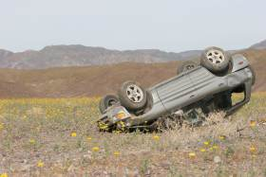
Those Pesky Humans
40% fatalities due to drinking
80% of accidents due to inattention
41 hours/year per person lost to congestion
3 parking spaces per car, up to 60% of land in LA is for cars
Over 25% of our energy budget, and more of CO2 output

Slide 5
No Longer Science Fiction
Darpa Grand Challenges
Google does 500,000 miles – over 90K without safety incident
Demos from many on ordinary roads
Watch Google’s video “Steve Mahan” on YouTube

Slide 6
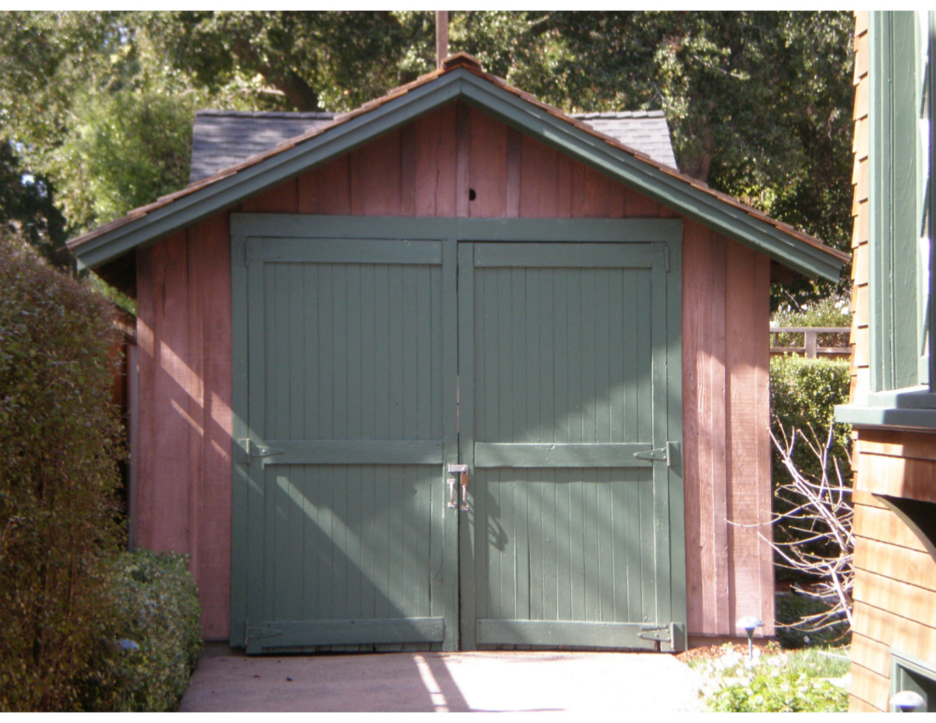
Garage Innovation

Slide 7
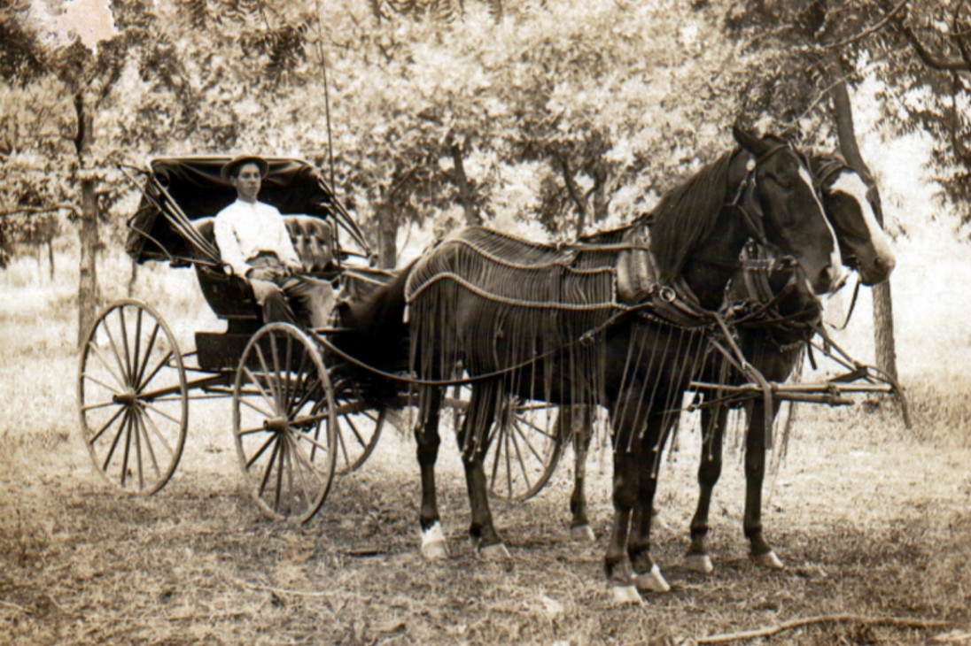
Not Science Fiction
DARPA Grand Challenges
500,000 miles by Google

Slide 8
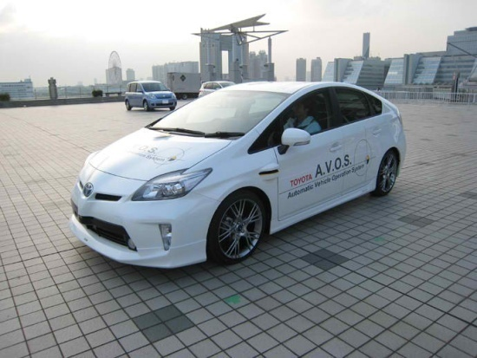
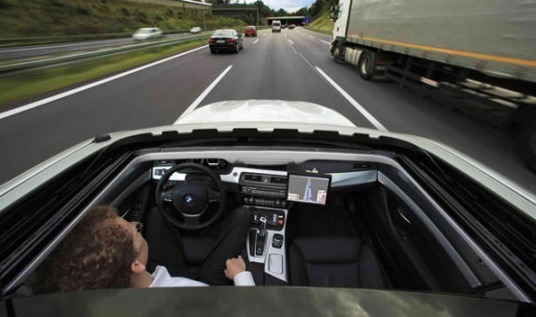
And Coming Soon
Cars galore with:
Self parking
Lane keeping warning/assist
Automatic Cruise Control
Pedestrian and collision detection/warning/braking
Now announced or demonstrated:
Mercedes 2014 S-Class with traffic jam autopilot
Audi, Volvo, others to follow suit
Google’s Brin says 2017
Mercedes and Nissan announce 2020
robocars.com
Notes:
8

Slide 9
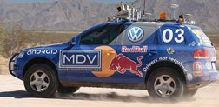
Huge Consequences
Hundreds of thousands of lives every year
Saving energy and ending U.S. Oil imports
200 million tons of CO2 per year
A $trillion of human productivity
Land reclaimed from parking
Freedom from congestion
Delivery of anything

Slide 10
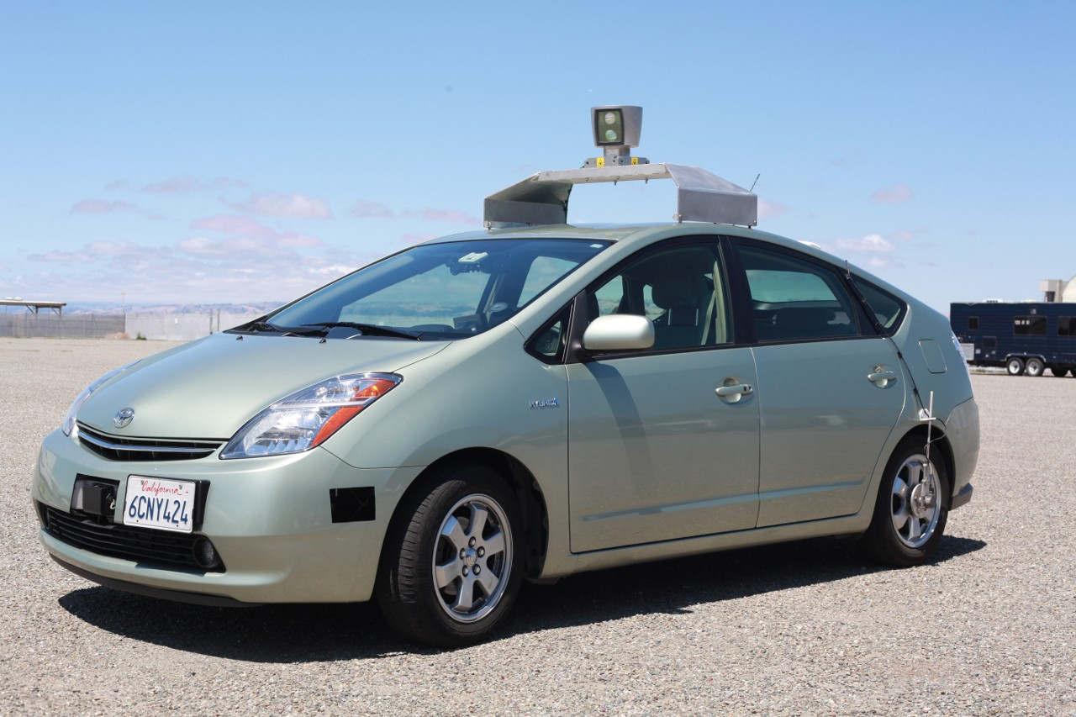
Programmers can save the world

Slide 11
What might it be like?
Push a button on your cell
A car comes in seconds
You ride in a pleasant work environment or face-to-face
You arrive at the elevator at your destination
No central control, no new infrastructure

Slide 12
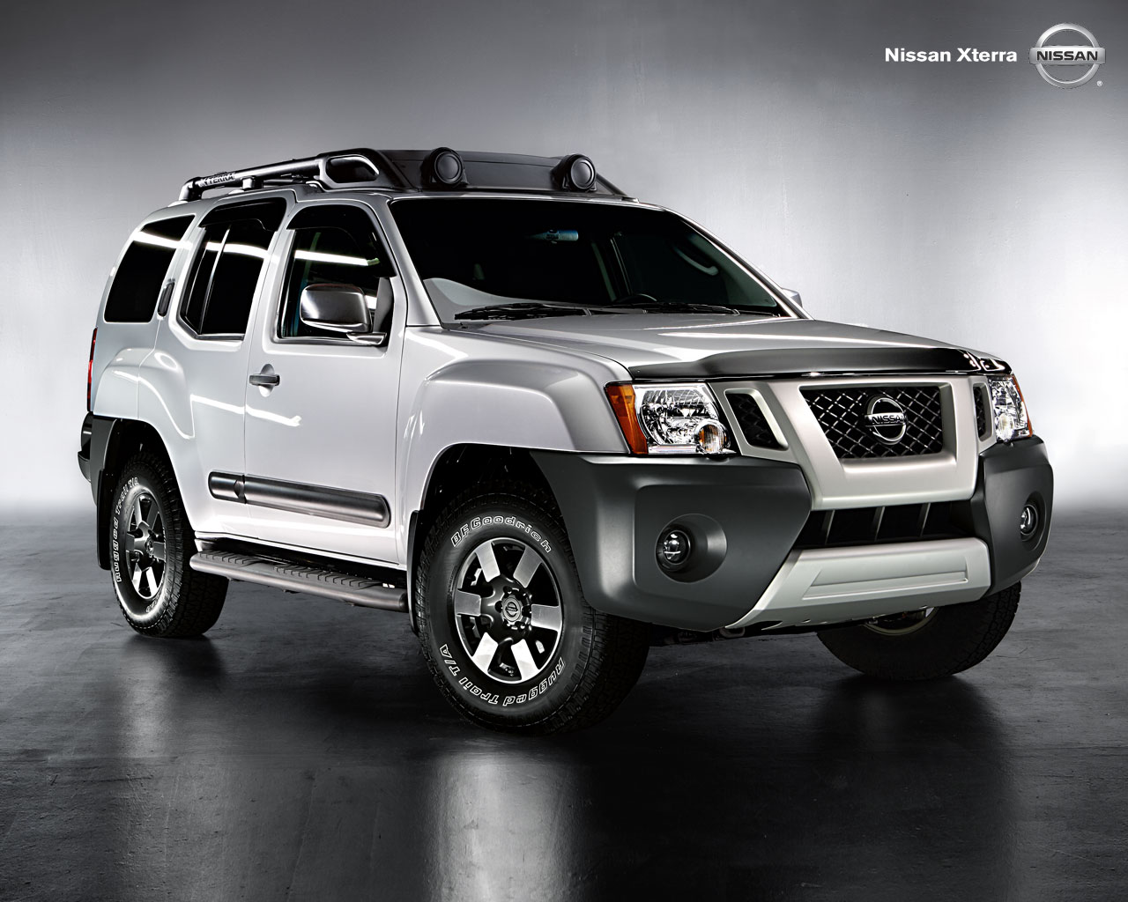
What car do I need for my life?

Slide 13
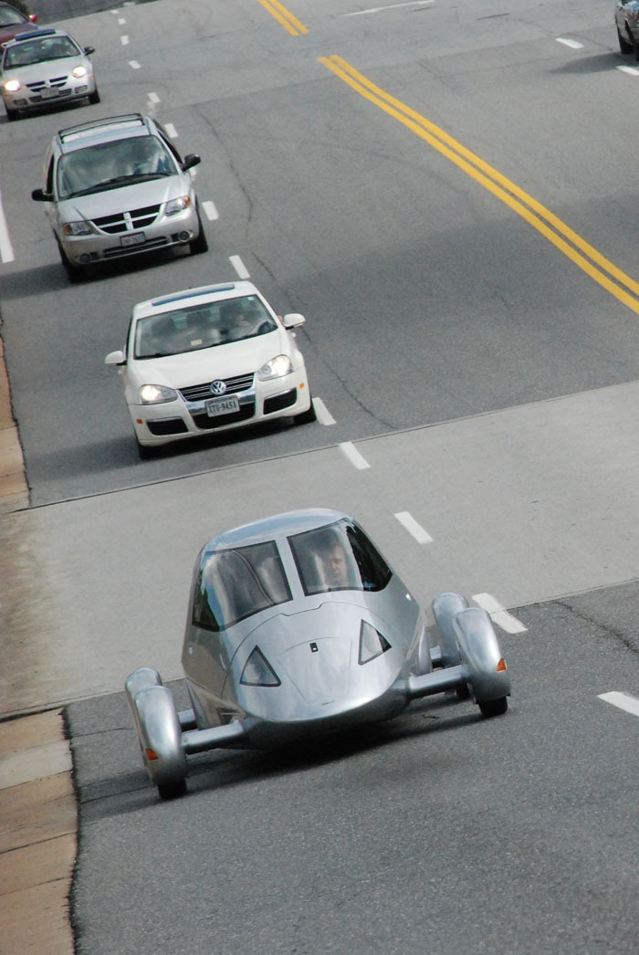
What car do I need today?
Mostly single person
Efficient, light
Not a 5 passenger sedan
Possibly narrow, face-to-face

Slide 14
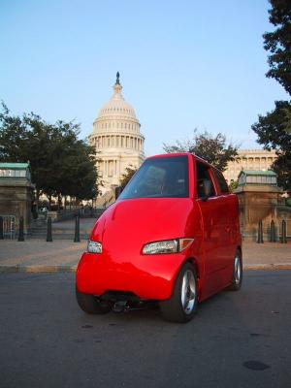
All Energy Becomes Easy
Robots don’t care about how convenient refueling or recharging is
Range, fuel, recharge times unimportant in a taxi
Gasoline’s 100 year headstart is broken
End import of overseas oil

Slide 15
Moore’s Law comes to Transportation
Competing innovators vs. 19th century
Compare:
Early Adopters vs. municipal government administrators
Big infrastructure vs. bottom-up growth with almost no new infrastructure

Slide 16
The purpose of the city:
Transportation
(Easy trips to what you need)

Slide 17
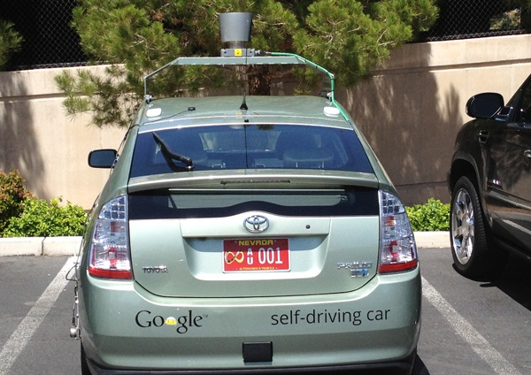
Political issues
Jurisdictions jumping at the chance to legalize
Nevada, Florida, California, DC passed laws
Lobbying will come from the aging, families, drunks and Jews

Slide 18
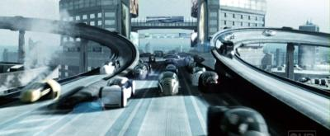
Downsides
Less walking
Longer trips, Robo-RV, super-sprawl
Computer Intrusion, Bugs
Sourcing electricity
Disruption
Empty cars
Killbots
Privacy
Freedom

Slide 19
Barriers
Law
Fear - PDLBKBR
Liability
Regulators
Terrorists – will drive-by-wire be banned?
S.M.O.P.
Software recalls

Slide 20
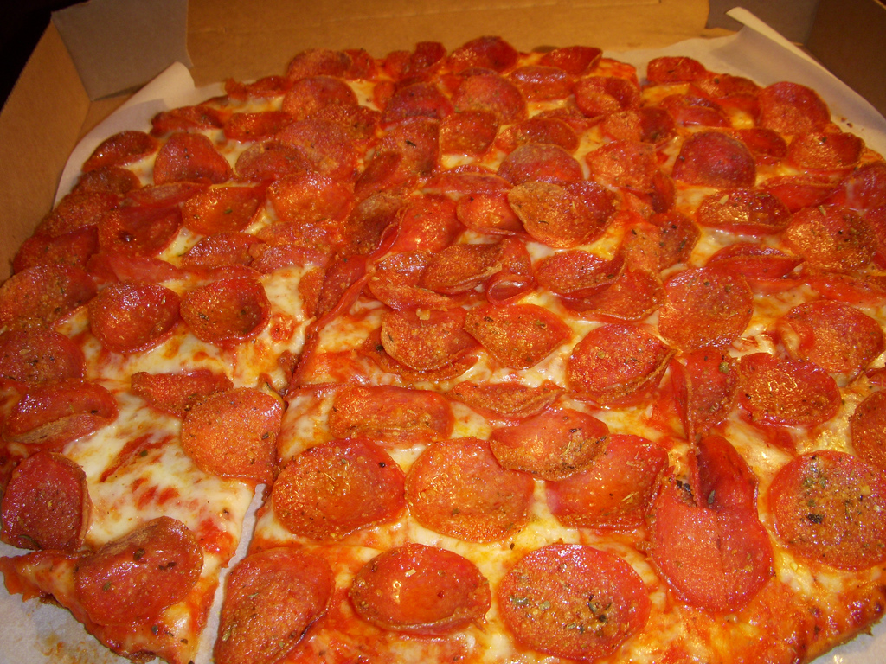
Deliverbots
In military, then on back streets
Anything in 30 minutes, not just pizza
No need to own expensive, rarely used goods – “room of requirement”
Vast alteration of the nature of retail
Also changes airports, farms etc.
Notes:
Total change of retailing. Enables sharing economy and room of requirement
Image by Navin75, Flickr.

Slide 21
The End of Parking
They don’t park they stand.
Can stand in driveways, in front of hydrants, double and triple parked
The more cars on road, the fewer parked

Slide 22
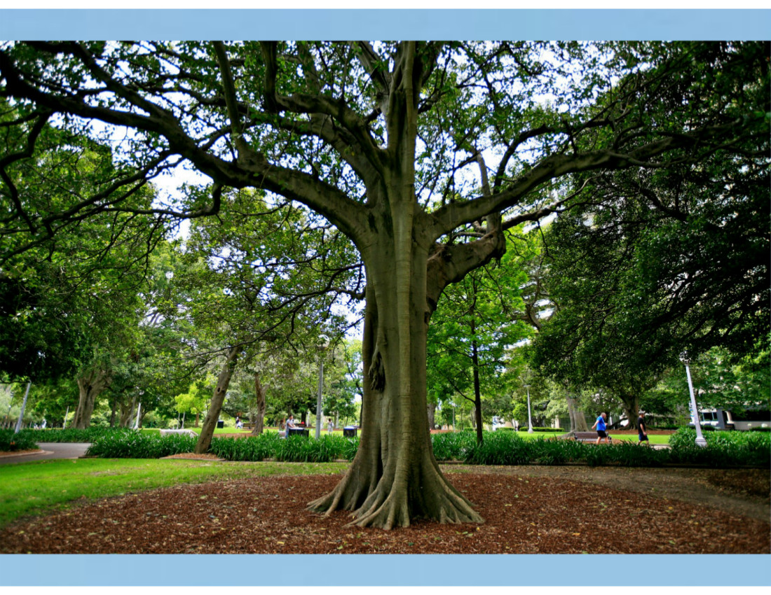
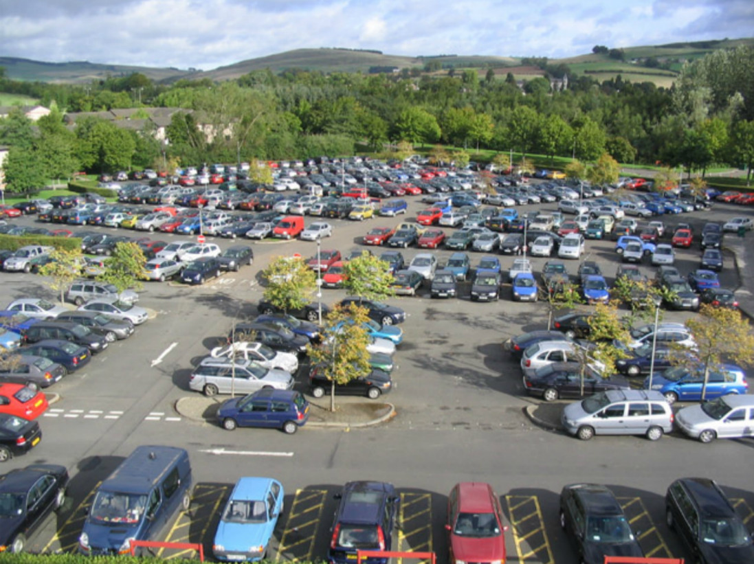

Slide 23
Death of Distance
“Poor man’s teleporter”
Commute times constant over the centuries
More or less sprawl?

Slide 24
End of Mass Transit
Small, light vehicles are more efficient and much nicer for the customers

Slide 25
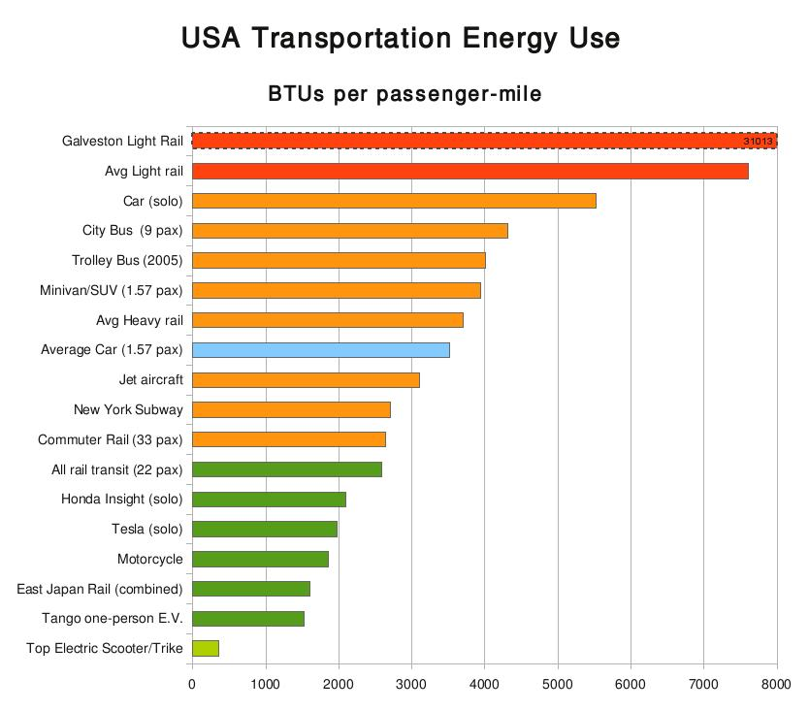

Slide 26
Transit Alternatives
On-demand vanpooling with JIT mode changes for capacity limitations
Private ROW makes less sense
Managed lanes are better
We may all walk less
Or we may walk more in multi-leg multi-mode trips

Slide 27
Congestion
Digital metering of roads before you leave
Half-width vehicles
Parking lanes vacated for driving
Streets redirected to one-way
Few accidents, irrational behaviours or selfish obstruction
Limited “induced demand”

Slide 28
The Rule of Children
More choice of schools
More mobility to visit friends and do activities
Lower density less of a barrier
The elderly and disabled also get full mobility and can age-in-place.

Slide 29
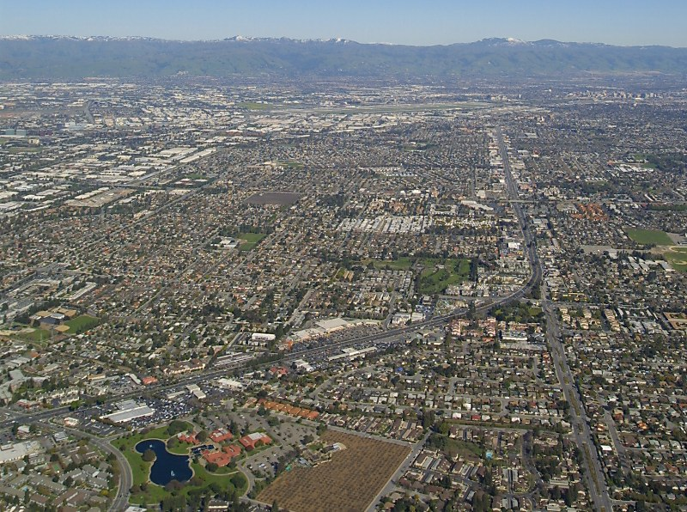
Parking-oriented Sprawl

Slide 30
Robocar Oriented Development
Walkable
Linear traversal possible
Quick pick-up/drop off points
Everybody within 2-miles of lower density housing sees it as “their neighbourhood”
Robot delivery of non-hand-carry goods
Polycentric

Slide 31
Trillion Dollar Revolutions
Major reductions in accidents and deaths
Energy saved and end of import of overseas oil and wars over it
Tens of billions of hours of productive time
Freedom and mobility to disabled, aged, young, poor
Decline of parking, transit, congestion and the re-rewriting of the city

